Slide 1


Semester Project 3 Car pooling System
Christian Sørensen, 267142
Cristian Guba, 254104
Flemming Vindelev, 251398
Ionel-Cristinel Putinica, 266123
Mihail Rumenov Kanchev, 266106

Slide 2
Table of contents
3 Tier Architecture Discussion
Java, C#
Razor
Web Services
Sockets
Security
Hashing
Patterns
Cookies
Back-up Servers
Monitoring
Version Control
Rating System
Conclusion

Slide 3
3 Tier Architecture

Slide 4
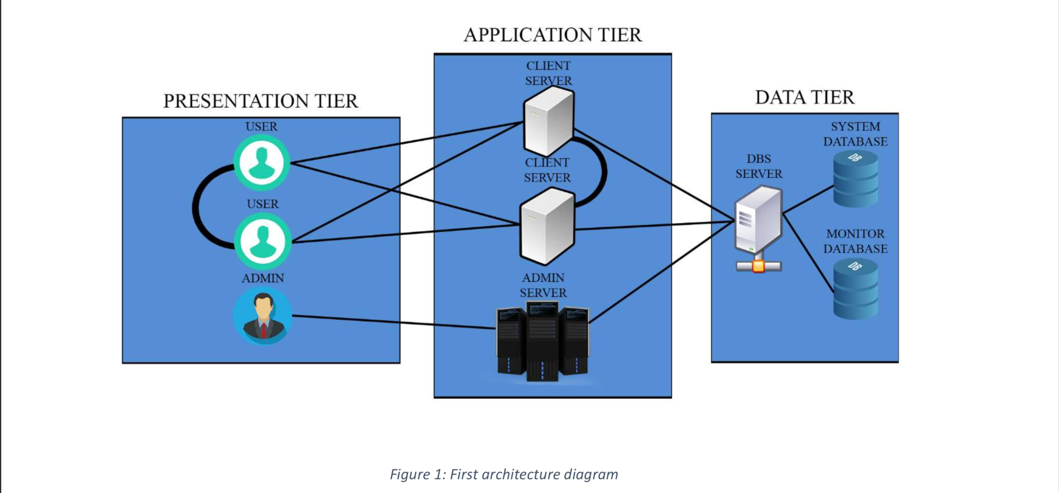
Initial design

Slide 5
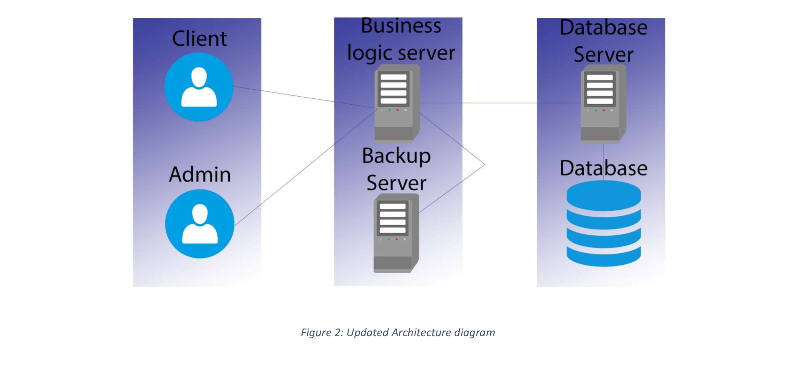
Updated design

Slide 6
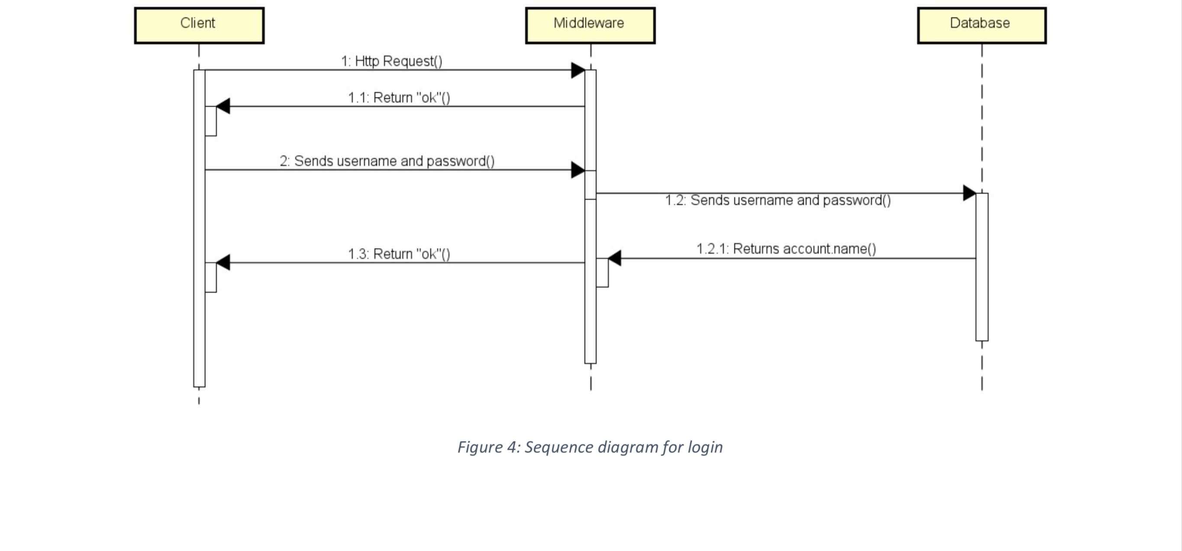

Slide 7

The Why? and How?

Slide 8
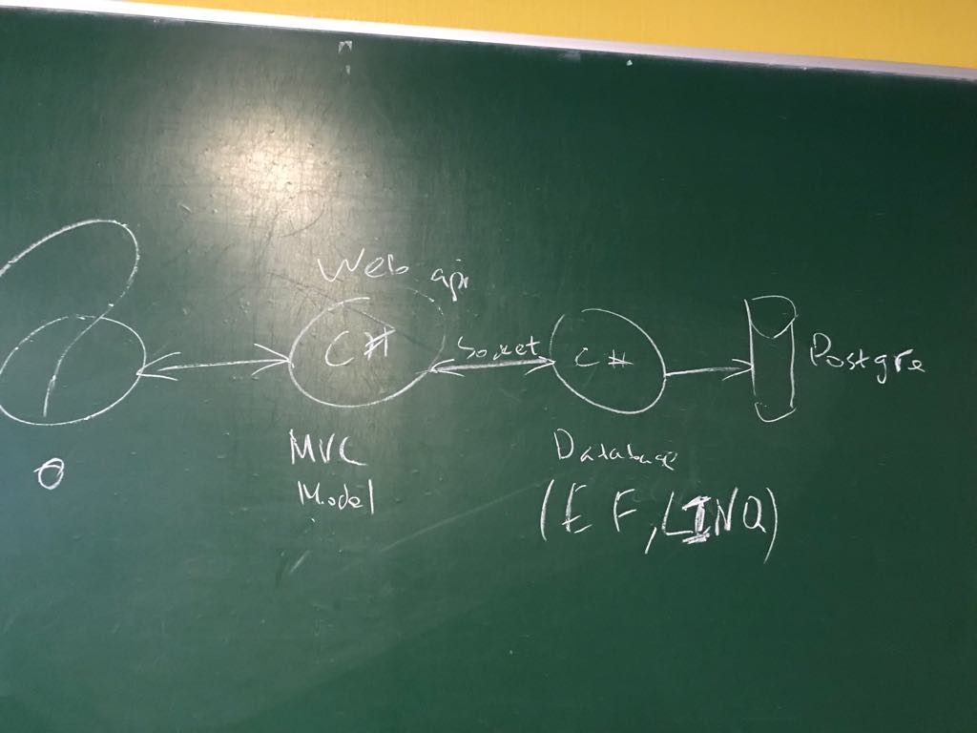
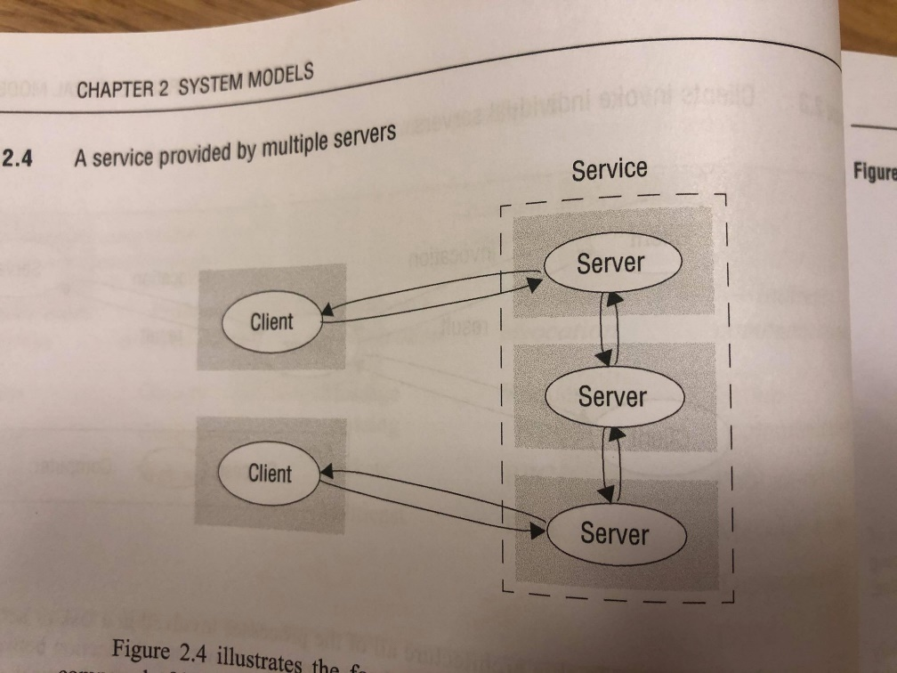
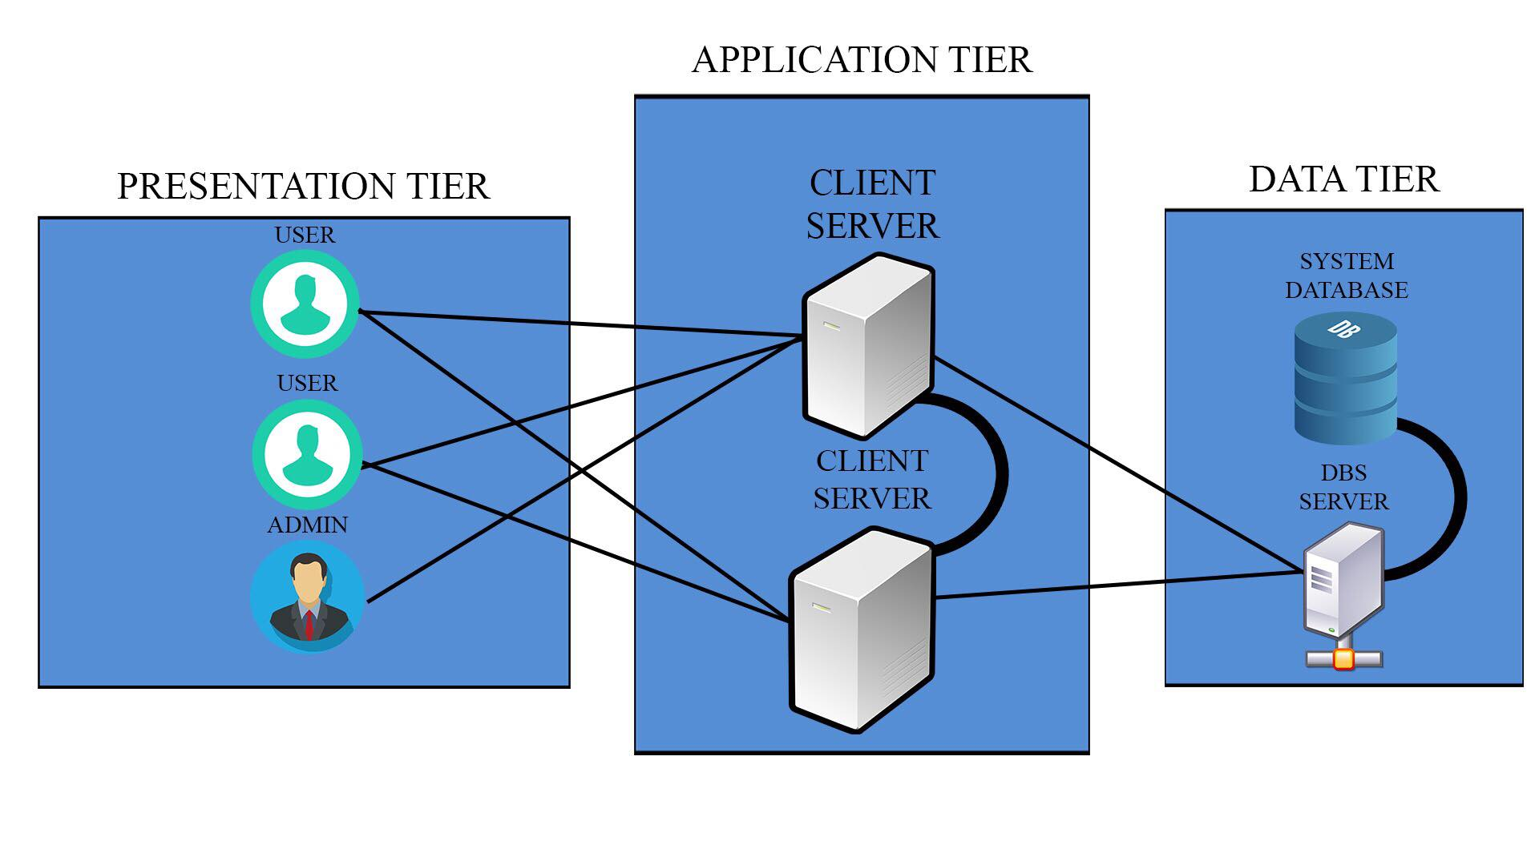

Slide 9
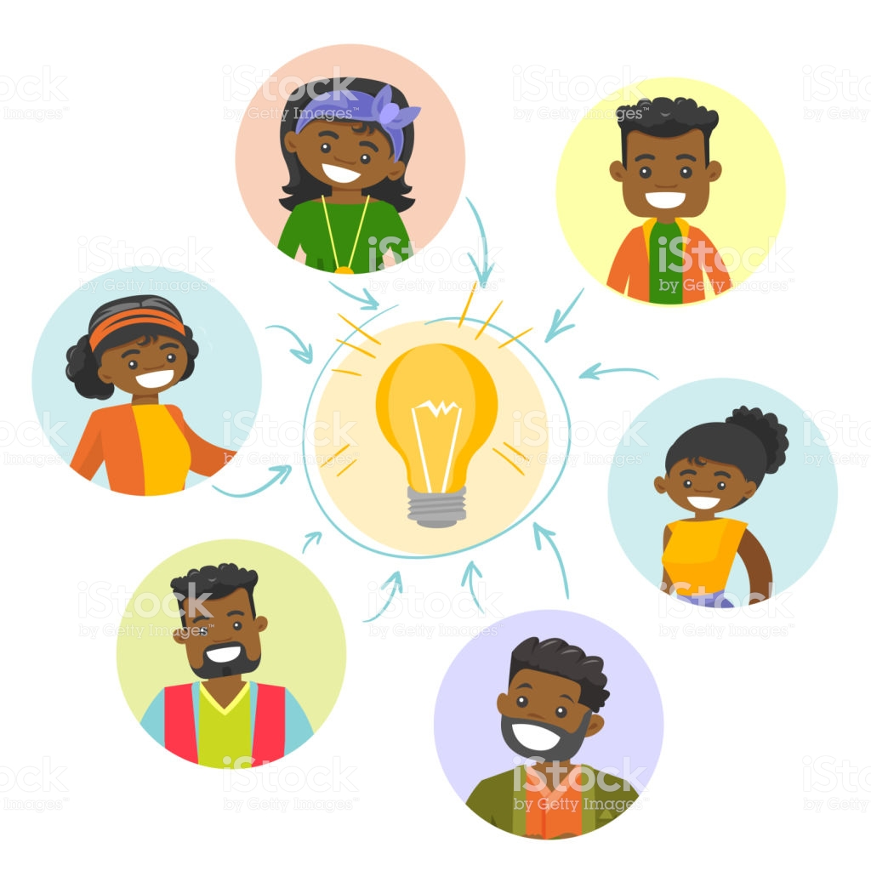
A lot of ideas

Slide 10

Why?
Is it time worthy?
How relevant is it?
Why the frick not?

Slide 11
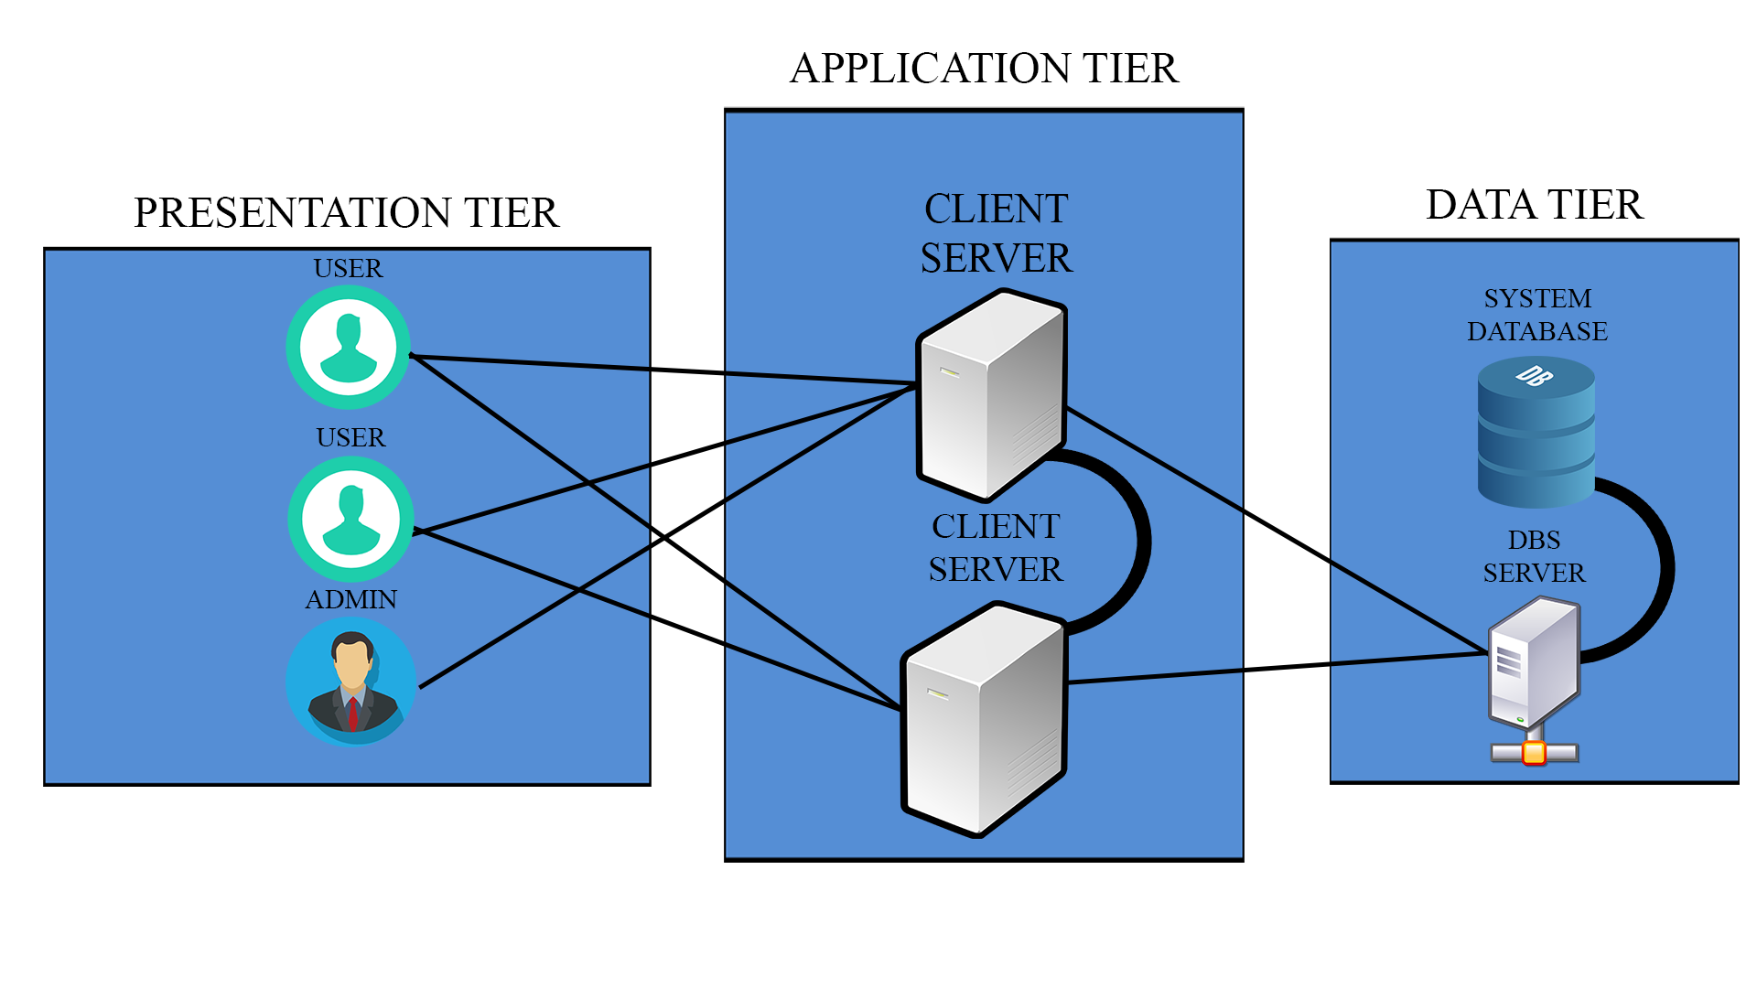
Ultimate design

Slide 12
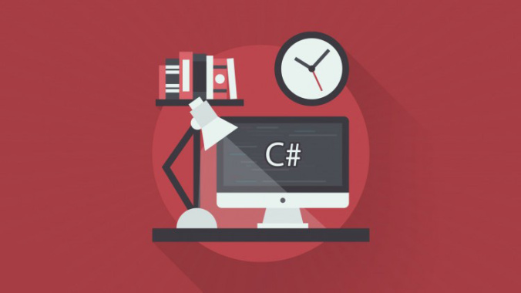

Slide 13


Back end
- Consistent code
- Migrations

Slide 14

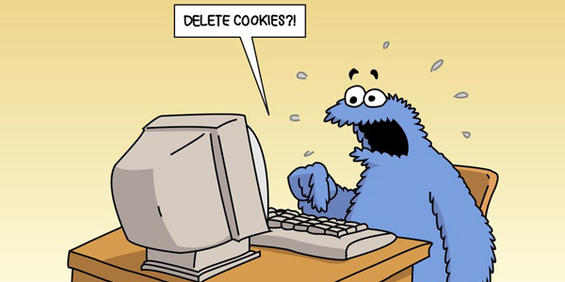
Front end
Fully customizable GUI
Easy to implement front-end security
Input validation
MVC

Slide 15

Middleware connections
Front to Mid. – Socket
Back to Mid. – Web Service

Slide 16

Why?

Slide 17


Slide 18


Slide 19
Webservices

Slide 20
Webservices
A requirement for the project was that the system must have both socket and webservice connections.
The system is desigend to have two connections
Which means: 1*socket connection, 1*webservice

Slide 21
Why Webservices?
Loose coupling
Allows services in various languages to communicate.
Security
Provides security measurements (Https)
Often used through a API for additional security.
Process intensity
Stateless and require no constant connection

Slide 22
Placement
Between database and middleware
We planned to monitor the connection between application and middleware tier.
Stateless would not allow that action.
Webservices made it easier to write to the database.

Slide 23
Choice of webservice
REST vs SOAP
REST is the winner!
Simple implementation in .NET
Sends Json objects
Relies only on HTTP

Slide 24
Middleware webservices
Middleware implemented i JAVA
Used Jersy external JAR files
Handy but hard to implement
Jersy makes a clinet for you.

Slide 25
Database tier
Implemented in C#
REST used through a web api

Slide 26
Sockets and Security

Slide 27

Where are the sockets?

Slide 28

Why?

Slide 29

How?

Slide 30
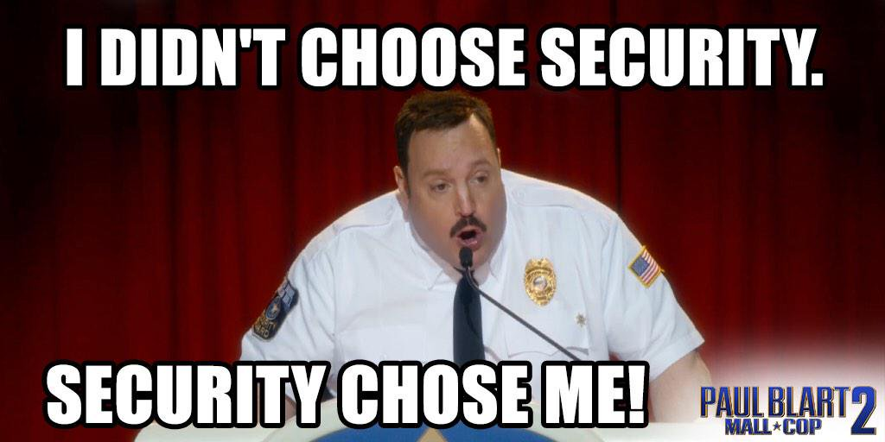
Security

Slide 31
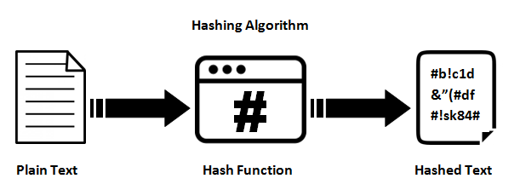
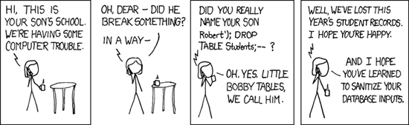
Hashing Database Sanitization

Slide 32

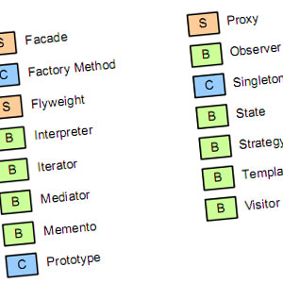


Design Patterns

Slide 33


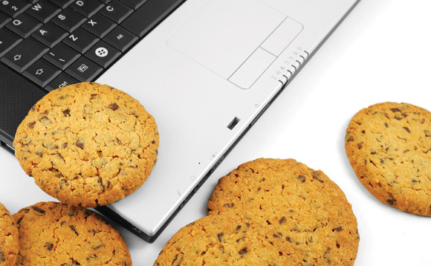
COOKIES!

Slide 34
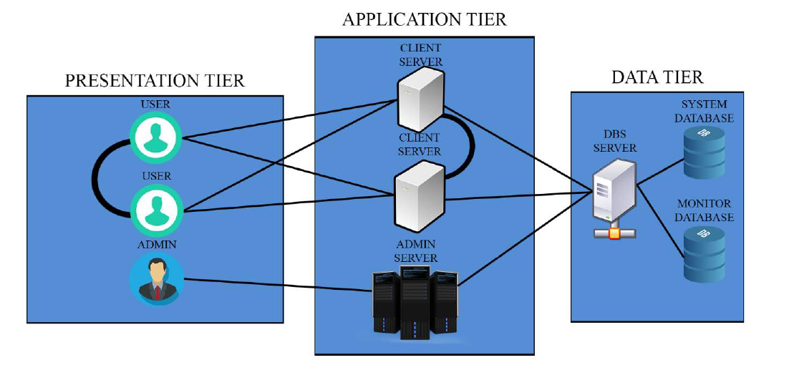
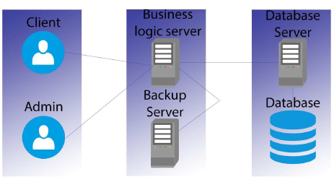
Back-up Servers
Original Architecture Diagram
Final Architecture Diagram

Slide 35

Monitoring

Slide 36






Version Control

Slide 37
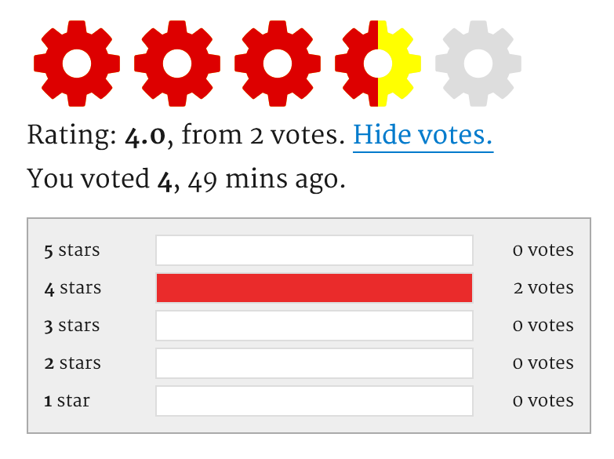
Rating System

Slide 38


Slide 39

Thanks for your attention!

